Slide 1


Slide 2

gfdsg
What’s new in .NET world
Miroslav Popović Technical Manager @Qinshift https://miroslavpopovic.com/
https://github.com/miroslavpopovic/
https://www.linkedin.com/in/miroslavpopovic/
@miroslavpopovic

Slide 4
Agenda
.NET languages BCL SDK Tools Performance improvements
EF Core ASP.NET Core Blazor MAUI gRPC …
Covering .NET 7 and 8, from 2022, onwards
https://github.com/miroslavpopovic/what-is-new-in-dotnet

Slide 5
Advanced Technology Days 18
.NET 8 Performance Boost with Native AOT – Marko Hrnčić
Blazor – stvari koje sam naučio na teži način – na stvarnim projektima – Mario Mucalo

Slide 6



Languages

Slide 7
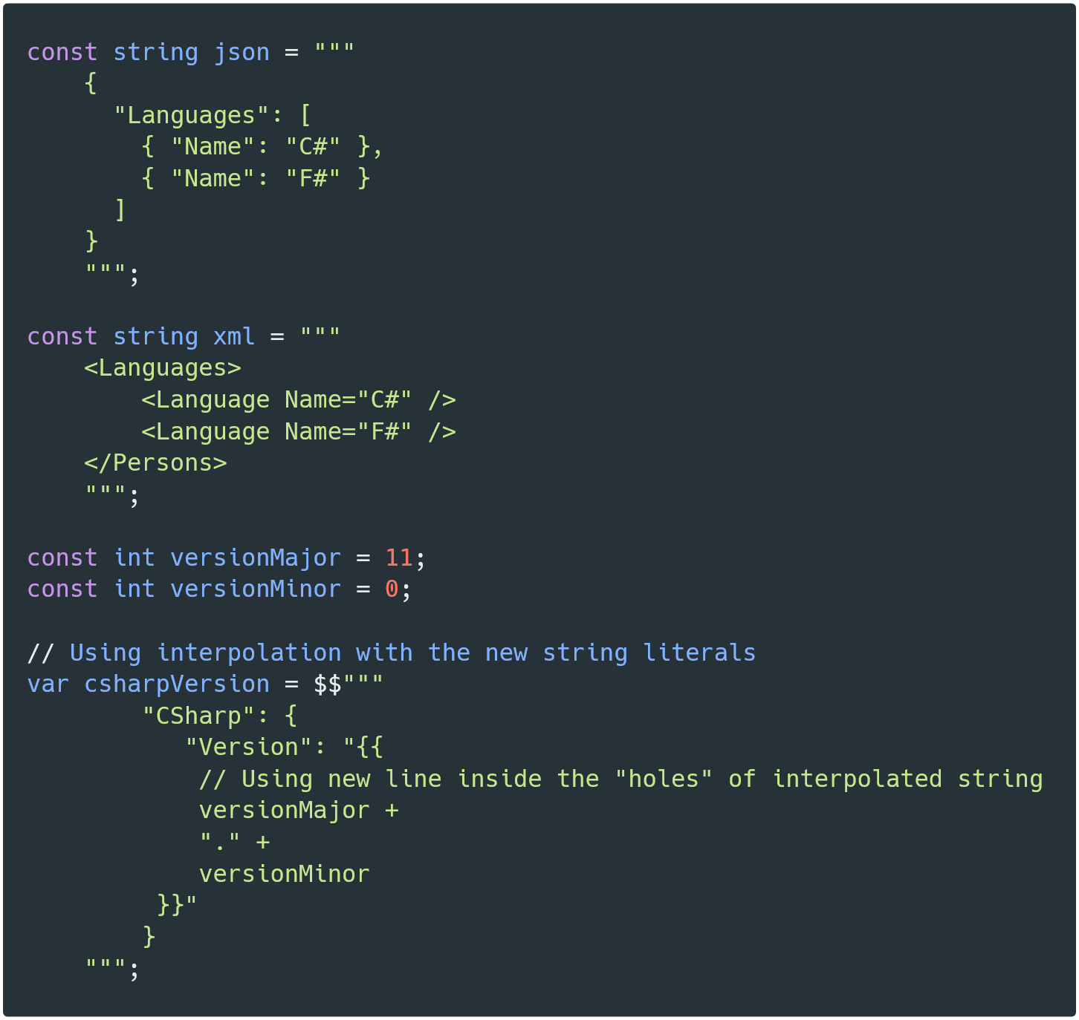
Raw string literals
11
Notes:
https://carbon.now.sh/uZvYPnveBuFOCY74EGih

Slide 8
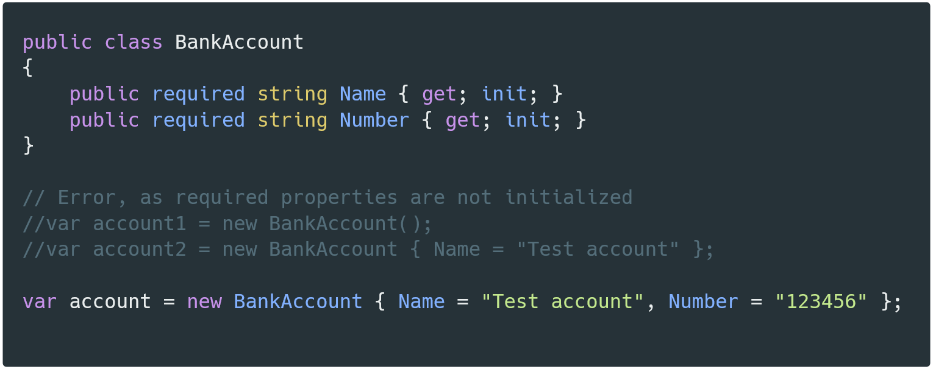
Required members
11
Notes:
https://carbon.now.sh/sz8QWqdfj5cbJcK3lAb9

Slide 9
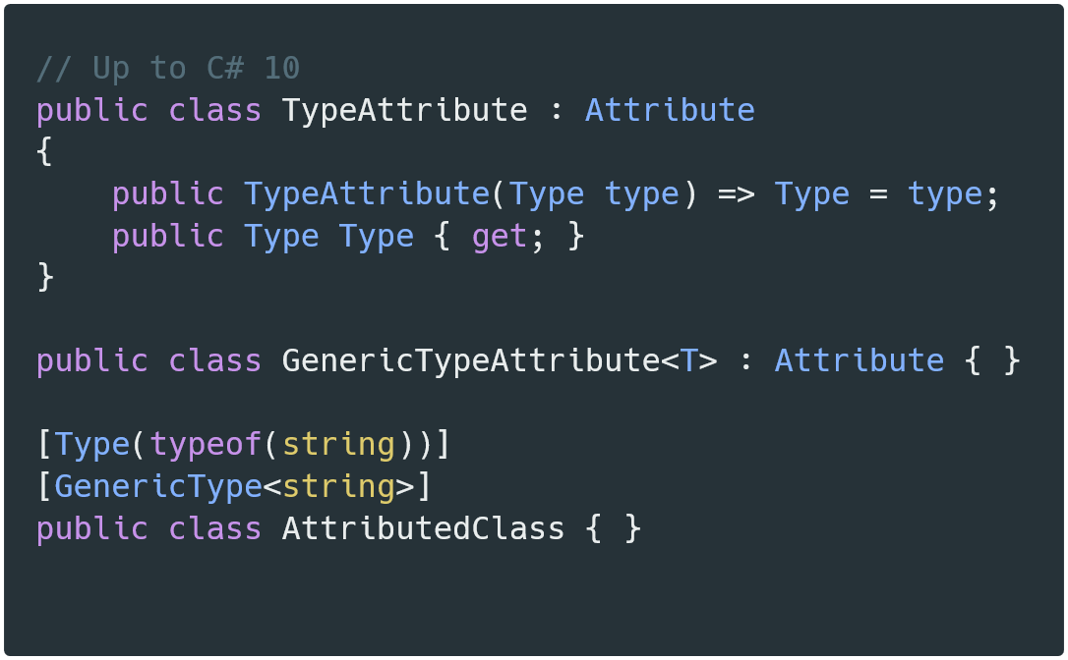
Generic attributes
11
Notes:
https://carbon.now.sh/vjexPel5uSOakJtdzhuT

Slide 10
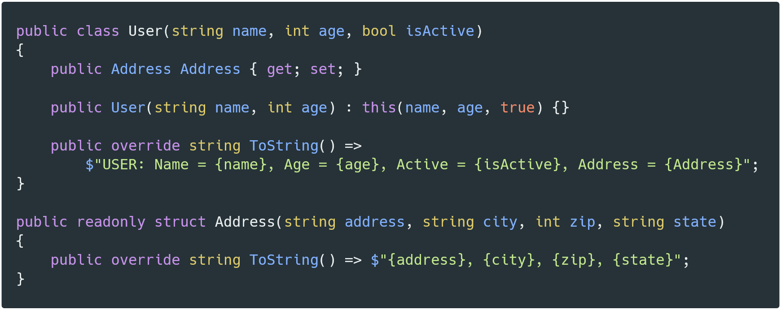
Primary constructors
12
Notes:
https://carbon.now.sh/YRG3fPH0afKTtAItUZs7

Slide 11
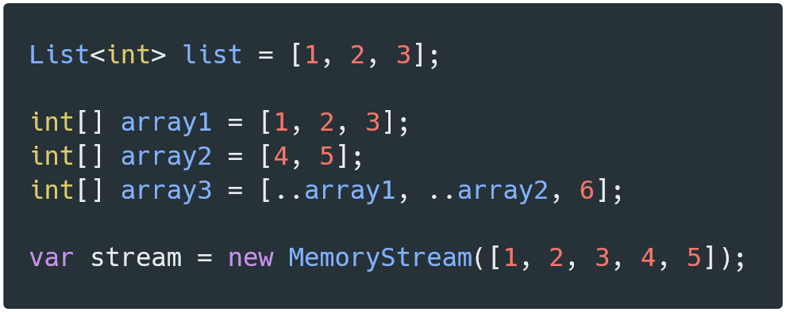
Collection expressions
12
Notes:
https://carbon.now.sh/3gafDEfsBlVIxzwC1wfo

Slide 12
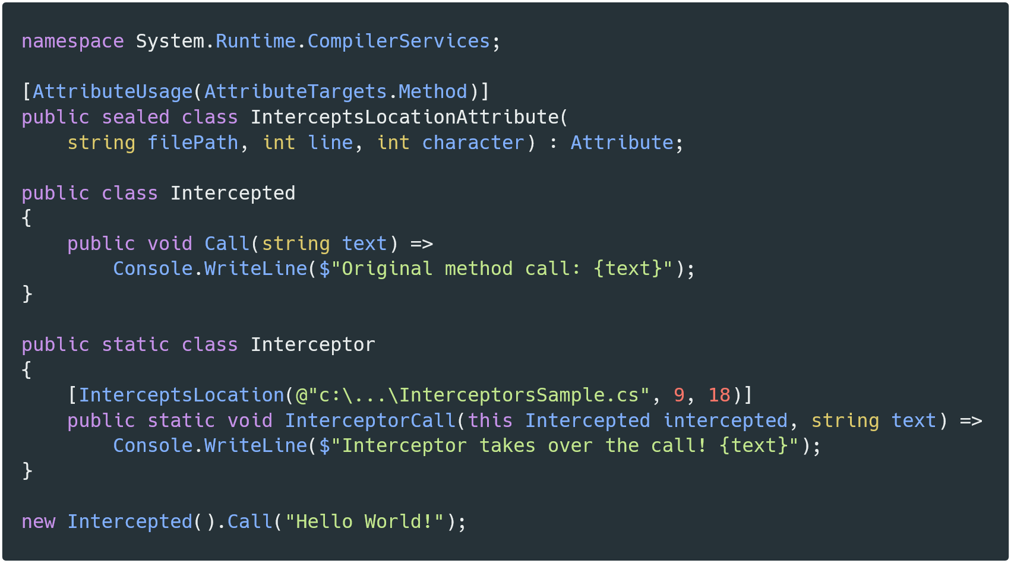
Interceptors
12
Notes:
https://carbon.now.sh/wzjM0U8Lu5rTDIM4anY4

Slide 13


Type system improvements
Pattern matching and other functional improvements
…
Shorthands
Uniformity
Diagnostics
Quality of life
Performance
…
NO new language features
VS improvements
New features of WinForms VB app framework

Slide 14
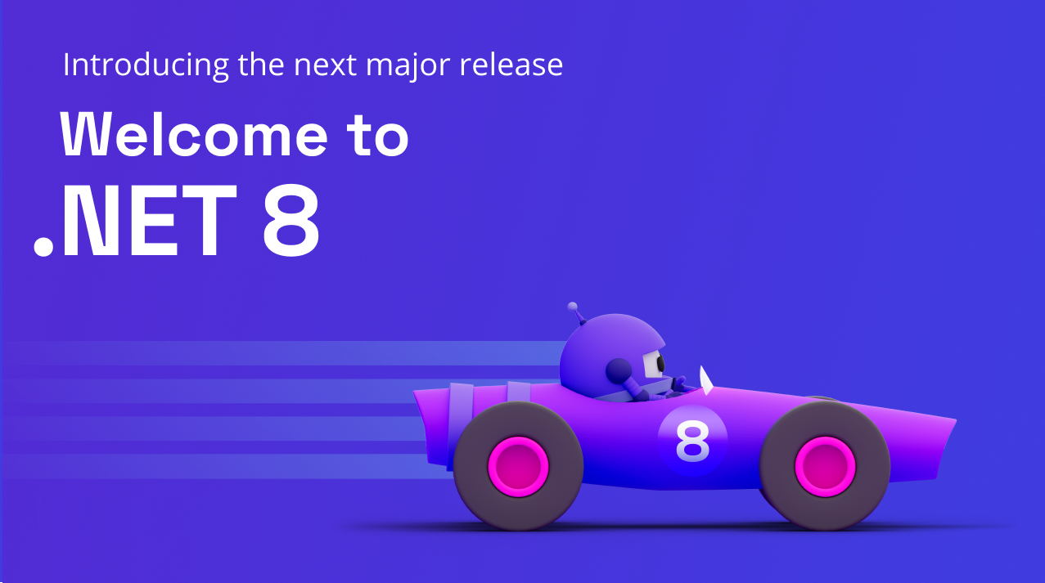
BCL and tools

Slide 15
Library APIs
.NET 7
.NET 8
Generic math
Rate limiting
QUIC support
…
TimeProvider
Configuration and options source generators
DI keyed service registration
…

Slide 16
System.Text.Json
.NET 7
.NET 8
Polymorphism
JSON contract customization
Performance
…
snake_case and kebab-case
Interface hierarchies
Performance and Native AOT
…

Slide 17
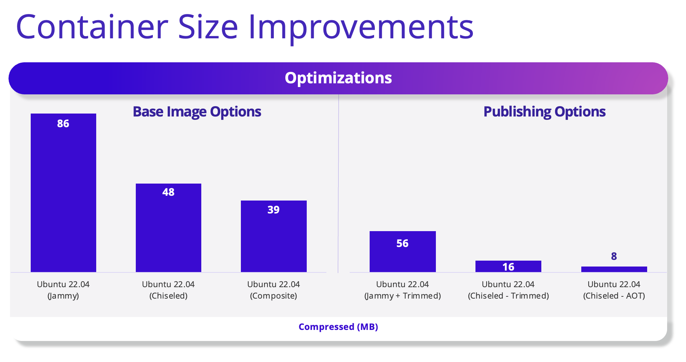
.NET SDK
.NET 7
.NET 8
Native AOT
Built-in container support
…
/artifacts folder output
dotnet build /tl
.NET container images improvements
Debian 12 (Bookworm) - default Linux distro
Ubuntu Chiseled container
Non-root user by default – app
Port 8080 by default
Publish to docker.io registry or tar.gz archive
…

Slide 18
Tools
.NET 7
.NET 8
Hot Reload improvements
Blazor WebAssembly, iOS and Android
NuGet 6.4
Central Package Management
Improved VS performance
…
Hot Reload
Modifying generics
NuGet improvements
Package source mappings
Vulnerability detection
…
Upgrade Assistant
Improved
Available from Visual Studio

Slide 19
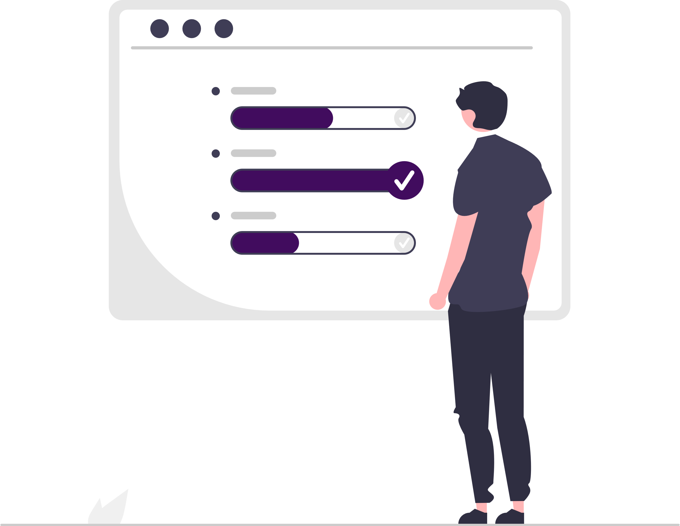
Performance improvements

Slide 20
Improvements
.NET 7
.NET 8
Regex
Source generator
Performance improvements
Arrays, strings, Collections and Spans
LINQ Min, Max, Sum, Average
...
Tiering and Dynamic PGO
Native AOT
Vectorization
Branching
Bounds Checking improvements
Constant Folding
Non-GC Heap
…

Slide 21

Entity Framework Core

Slide 22
New in EF Core
.NET 7
.NET 8
JSON columns in relational DBs
Bulk updates
Map CUD to stored procedures
Table-per-concrete-type (TPC) mapping
...
Raw SQL queries for unmapped types
Complex types as value objects
SQL Server HierarchyId support
MongoDB provider for EF Core
Maintained by MongoDB
…

Slide 23


ASP.NET Core

Slide 24
Features
.NET 7
.NET 8
RateLimiting middleware
Output caching middleware
Incremental ASP.NET migration tooling
…
Auth experience
Request timeouts middleware
AntiForgery middleware
New Visual Studio templates
Angular, React, Vue, .esproj
…

Slide 25
Minimal APIs in ASP.NET Core
.NET 7
.NET 8
IEndpointFilter support
IFormFile and IFormFileCollection
TypedResults
Route groups with MapGroup()
…
Native AOT support
Request Delegate Generator
…

Slide 26
SignalR
.NET 7
.NET 8
Client source generator
DI for hub methods
…
SignalR seamless reconnect
…

Slide 27

Blazor
.NET 7
.NET 8
System.Security.Cryptography support
Blazor custom elements no longer experimental
QuickGrid component [experimental]
.NET WebAssembly runtime
WebAssembly multithreading [experimental]
…
(Just) Blazor
Server-side, streaming and interactive rendering, auto-render mode
New Blazor Web App project template
Blazor Identity UI
Sections
QuickGrid no longer experimental
Experimental Webcil format
jiterpreter
…

Slide 28

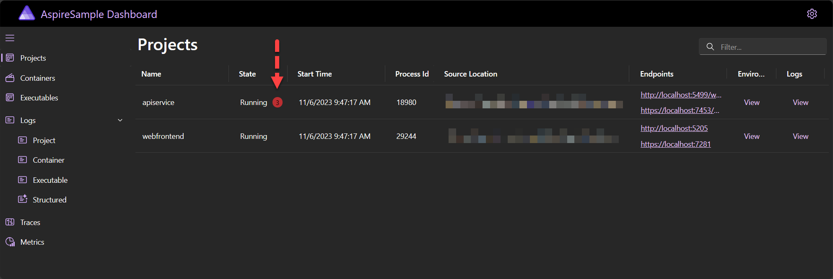
.NET Aspire
Distributed applications stack
Templates
Orchestration
Components
Dashboard
Tooling

Slide 29

MAUI

Slide 30
Features
.NET 7
.NET 8
iOS, Android, macOS, Windows, Tizen
Single project, platform folders
Hot Reload
Third-party components
DevExpress, Syncfusion, Telerik...
MAUI Community Toolkit
…
Improving quality
Xamarin.Forms upgrade to .NET MAUI with .NET Upgrade Assistant
Native AOT support for iOS and Android
…

Slide 31

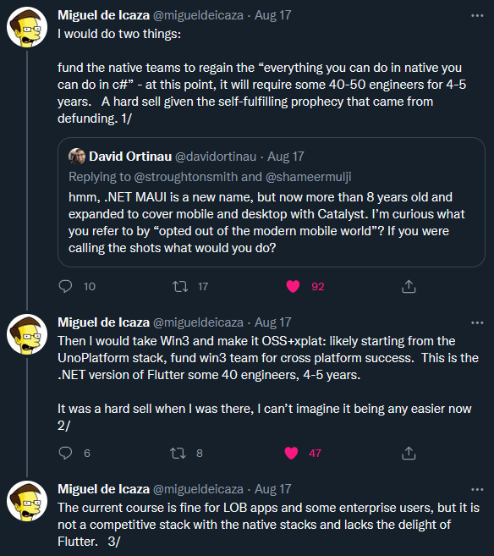

Is it ready?
Notes:
https://visualstudiomagazine.com/articles/2022/09/29/net-maui-complaints.aspx
https://twitter.com/migueldeicaza/status/1559898665350832128

Slide 32



Alternatives
Blazor Hybrid - https://learn.microsoft.com/en-us/aspnet/core/blazor/hybrid/
Uno platform - https://platform.uno/
Avalonia UI - https://avaloniaui.net/
Flutter - https://flutter.dev/
Notes:
https://platform.uno/blog/top-50-reasons-to-use-uno-platform-2022-edition/

Slide 33

Other

Slide 34

gRPC
.NET 7
.NET 8
JSON transcoding
Use like RESTful HTTP APIs
Native AOT support
Both client and server apps

Slide 35
Desktop
.NET 7
.NET 8
Windows Forms
MVVM
Custom controls for WinForm’s out-of-process designer
…
WPF
Performance improvements
Template updates
…
WPF
OpenFolderDialog
WPF Hardware Acceleration in RDP

Slide 36
Monitoring and metrics
.NET 7
.NET 8
Metrics for Microsoft.Extensions.Caching
Metrics for ASP.NET Core hosting, Kestrel and SignalR
Azure Monitor OpenTelemetry distro library
ASP.NET Core apps metric testing
With IMeterFactory and MetricCollector<T>
New, improved, and renamed counters

Slide 37
Ecosystem

Slide 38
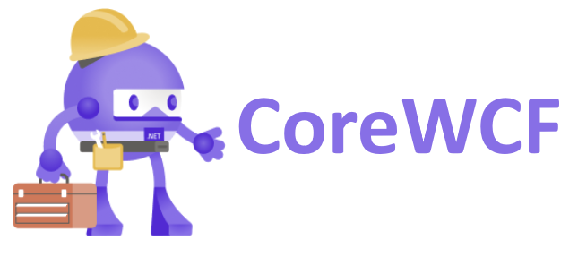
CoreWCF
1.0 released in April 2022.
Community project
Features are a subset of functionality from WCF
.NET Upgrade Assistant can migrate WCF services to CoreWCF

Slide 39
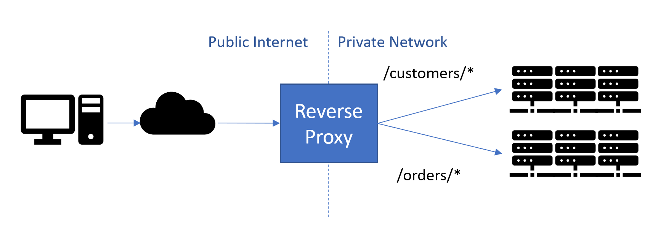
YARP
YARP = Yet another reverse proxy
Configuration via static config files, or programmatic
Load balancing
Authentication and authorization
HTTP/3 support
Proxying URLs and header transformation
Cloud-scale performance
Easily extensible
Open-source
…

Slide 40
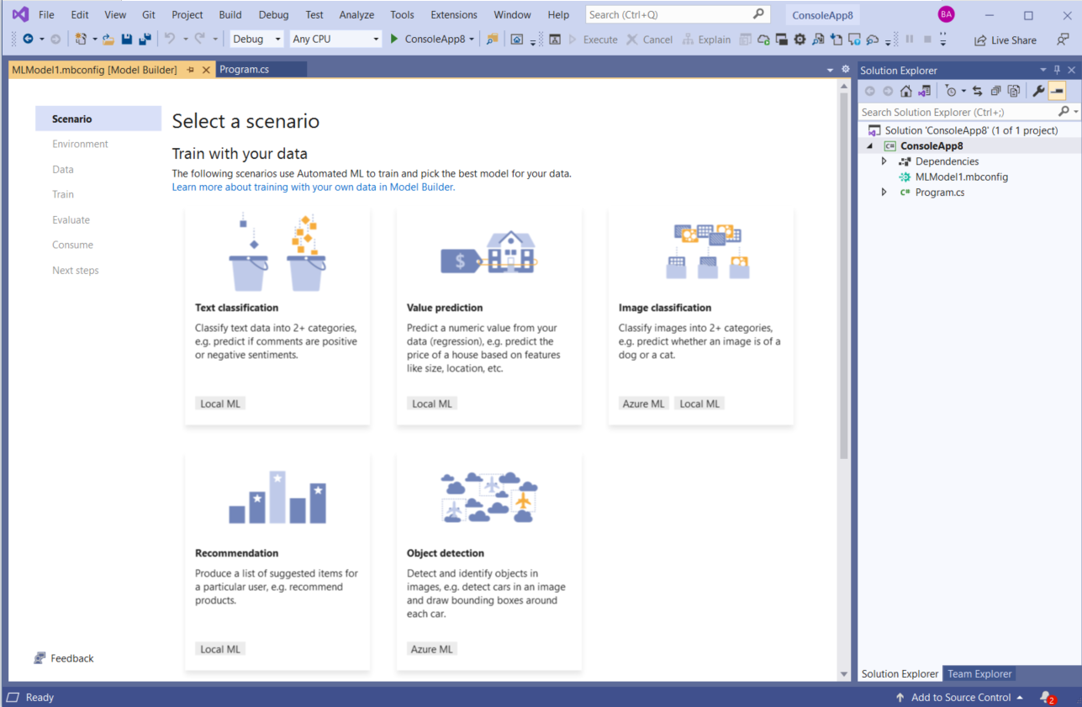
ML.NET
Open-source, cross-platform machine learning framework
Microsoft.Extensions.ML NuGet package
Model Builder
AutoML
Notebook Editor in VS
Current version is 3.0
Notes:
https://github.com/dotnet/machinelearning

Slide 41
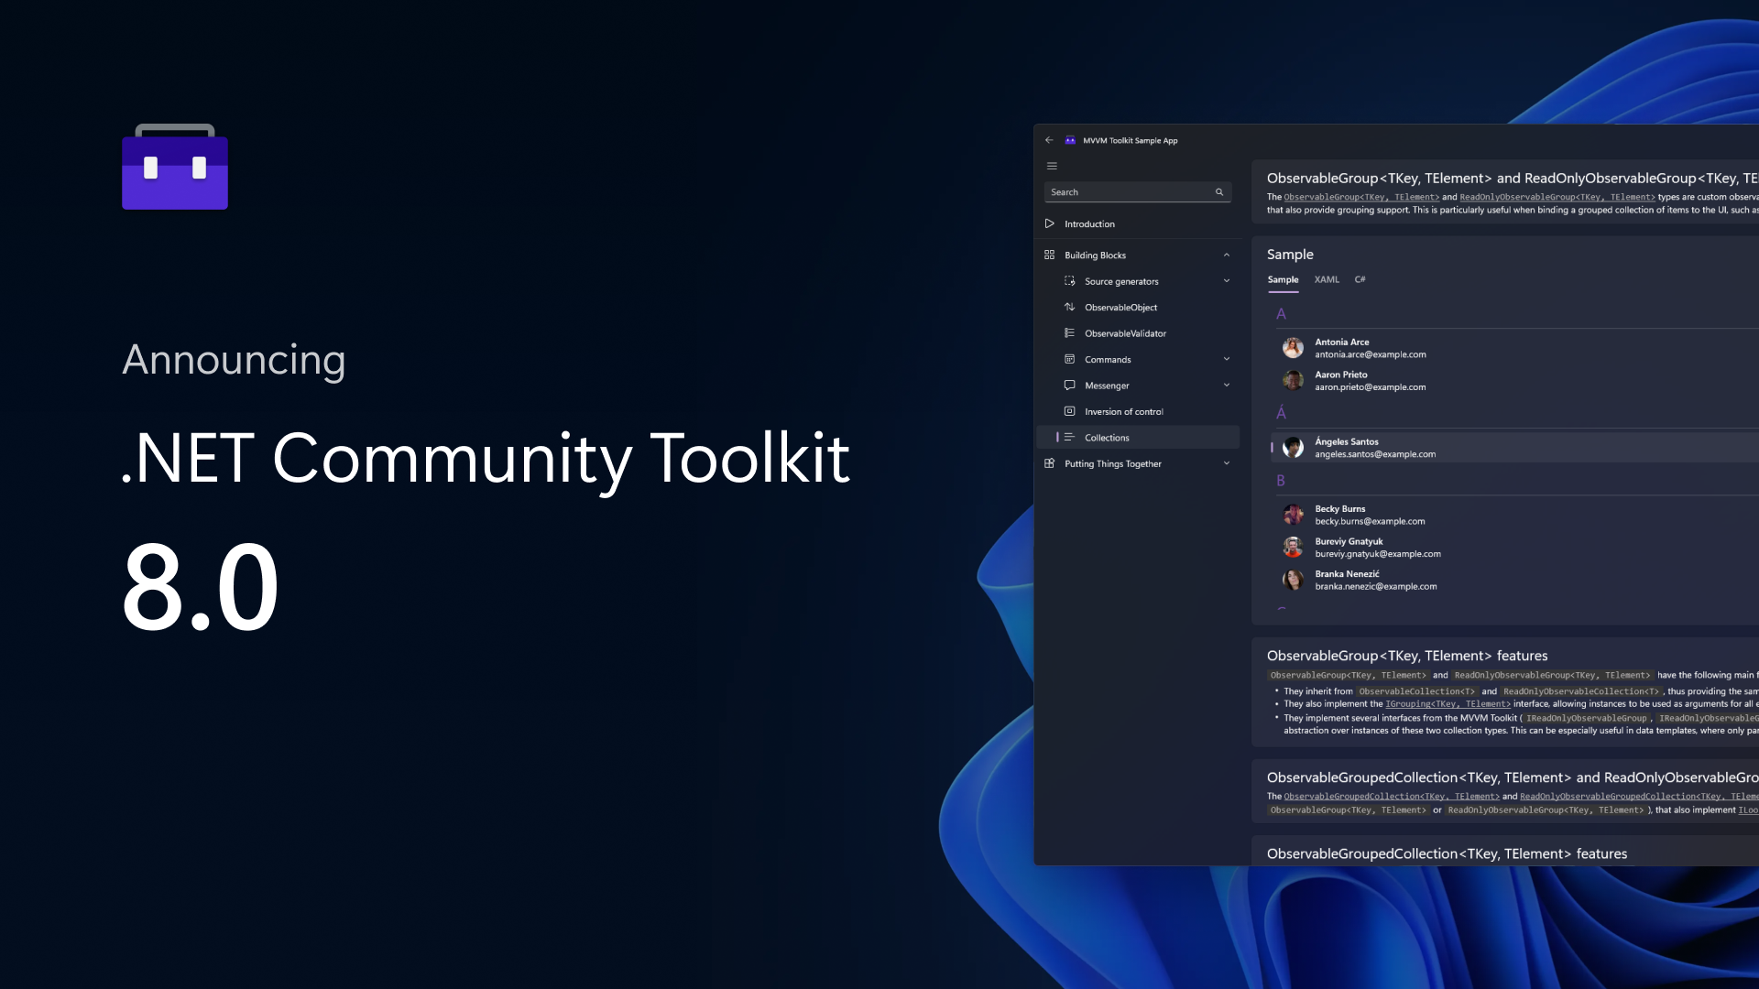
.NET Community Toolkit
Helpers and APIs for any UI platform
MVVM Toolkit
Inspired by MvvmLight
Source generators
Commands
Observable properties
Roslyn analyzers
Sample app
Other toolkits
Windows Community Toolkit
.NET MAUI Community Toolkit
Notes:
https://learn.microsoft.com/en-us/dotnet/communitytoolkit/introduction

Slide 42

Other libraries and frameworks
Polly
v8 released in September 2023.
Source Code generators
Mapperly
Dunet
Generator.Equals
https://wengier.com/SourceGeneratorPlayground/
Sisk
An alternative .NET HTTP Server
https://sisk.project-principium.dev/
Distributed apps
Dapr
Microsoft Orleans

Slide 43
Cloud and dogfooding
AppService is using Kestrel + YARP
Azure Functions supports latest .NET
Amazon EC2 and AWS Lambda supports latest .NET
Dynamics 365 is using YARP
On latest .NET
Azure Active Directory Gateway
Microsoft Graph
Azure Cosmos DB
Exchange Online
Microsoft Commerce
Microsoft Teams Infrastructure and Assignments
Bing Ads
OneService
Bing
…
Notes:
https://github.com/miroslavpopovic/what-is-new-in-dotnet#cloud-and-dogfooding

Slide 44
Dev tools

Slide 45

Visual Studio
Git improvements
multi-branch, line staging, graphs, PRs, summary difs…
Hot Reload
UI refresh
Dev Tunnels for web applications
.NET Upgrade Assistant
.http file support
Debugging and diagnostics, performance improvements
Visual Studio for Mac retirement announced
…
Notes:
https://visualstudio.microsoft.com/vs/

Slide 46

Visual Studio Code
https://vscode.dev/
Visual Studio Code Server
C# Dev Kit
C# extension enhanced (OmniSharp), IntelliCode, .NET runtime install, Solution Explorer…
…
Notes:
https://devblogs.microsoft.com/dotnet/announcing-visual-studio-code-extension-for-tye/

Slide 47

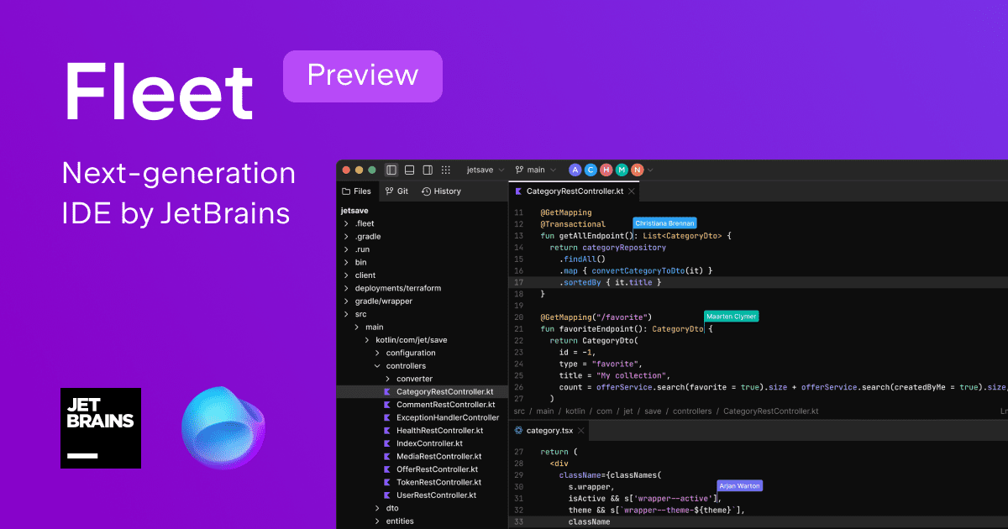


JetBrains
ReSharper
Rider
Fleet

Slide 48
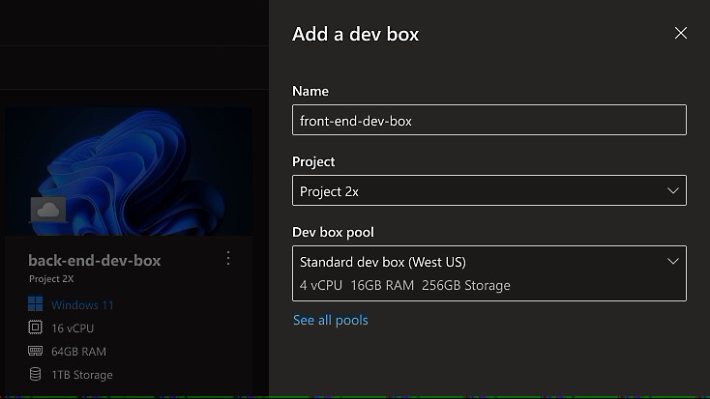
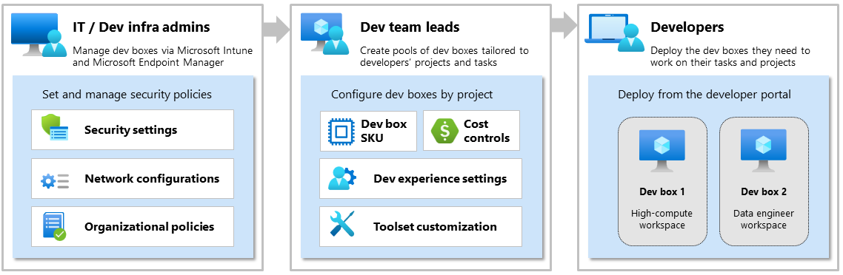
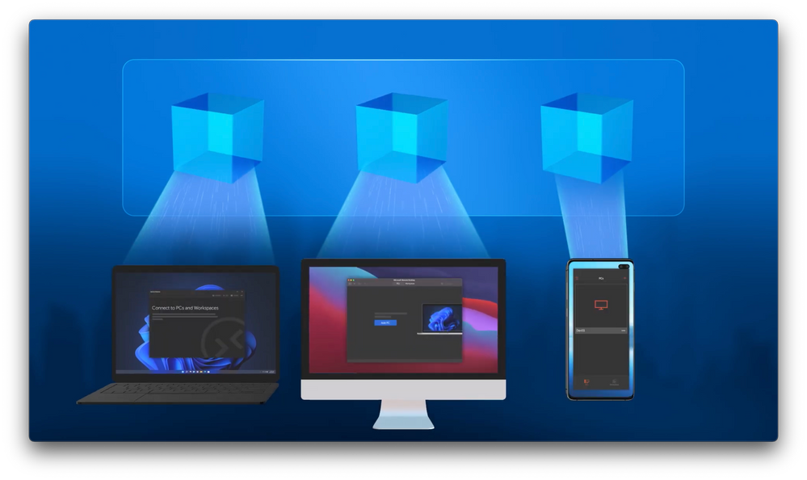
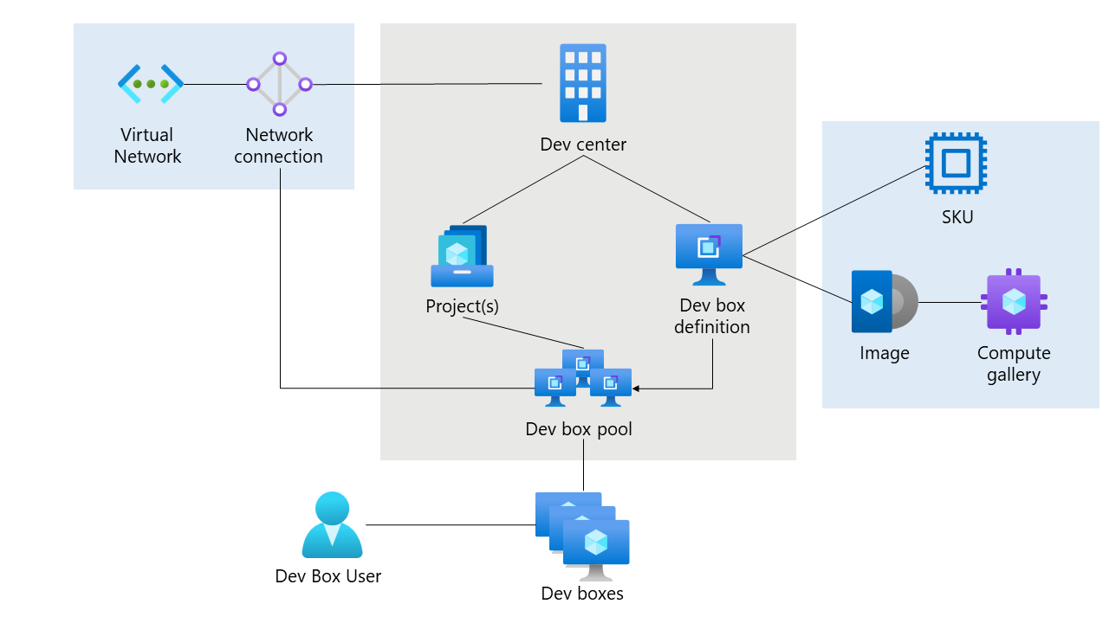
Microsoft Dev Box – cloud workstations
Notes:
https://azure.microsoft.com/en-us/blog/announcing-microsoft-dev-box-preview/

Slide 49
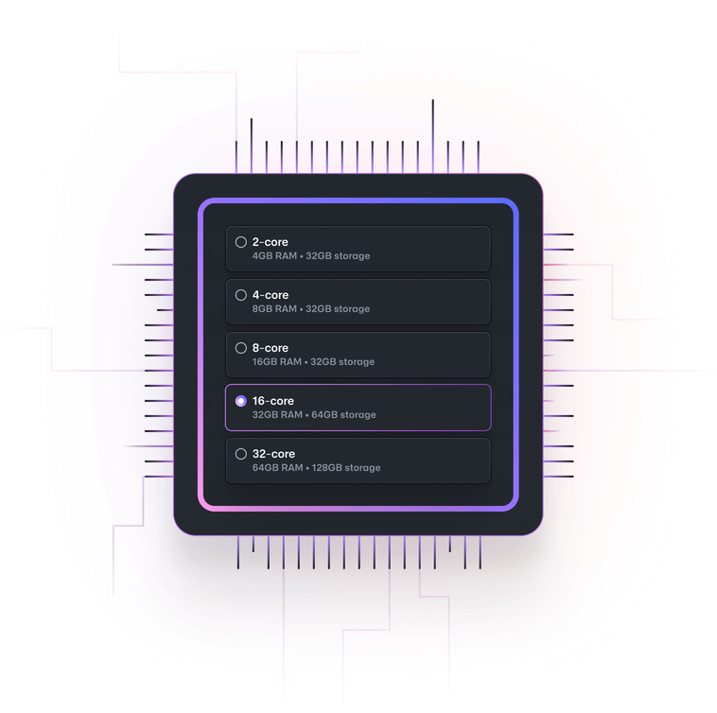
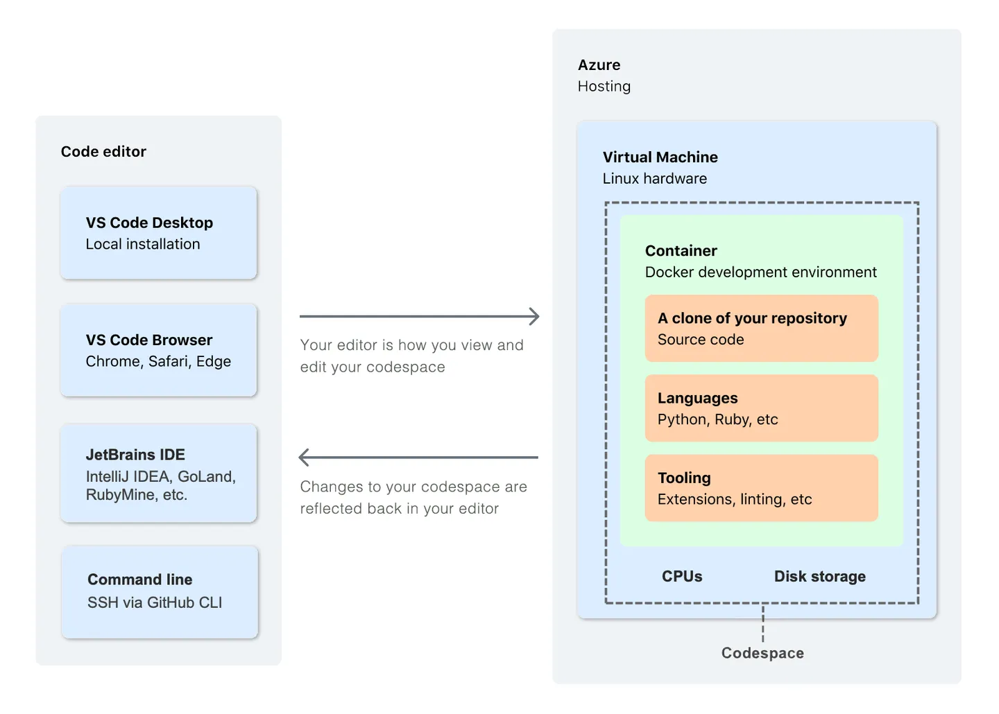
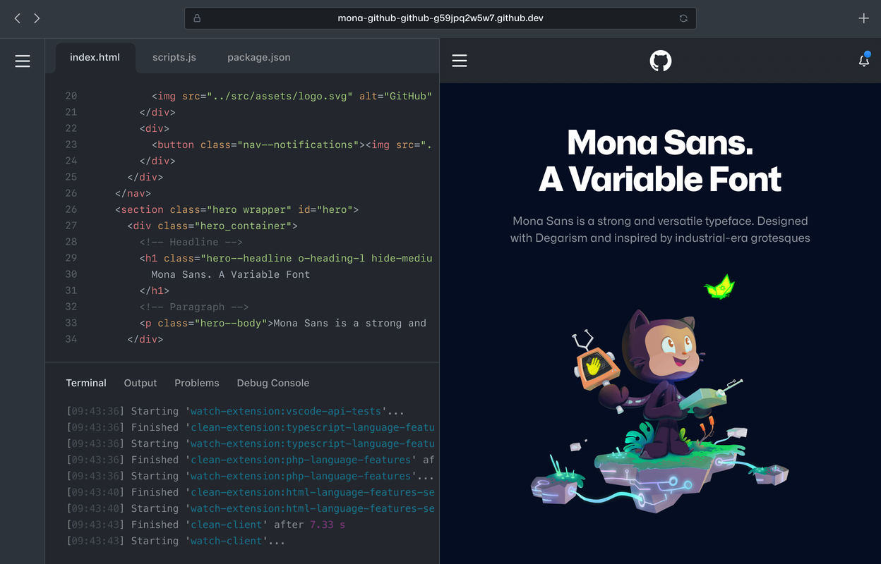

GitHub Codespaces
Notes:
https://docs.github.com/en/codespaces

Slide 50
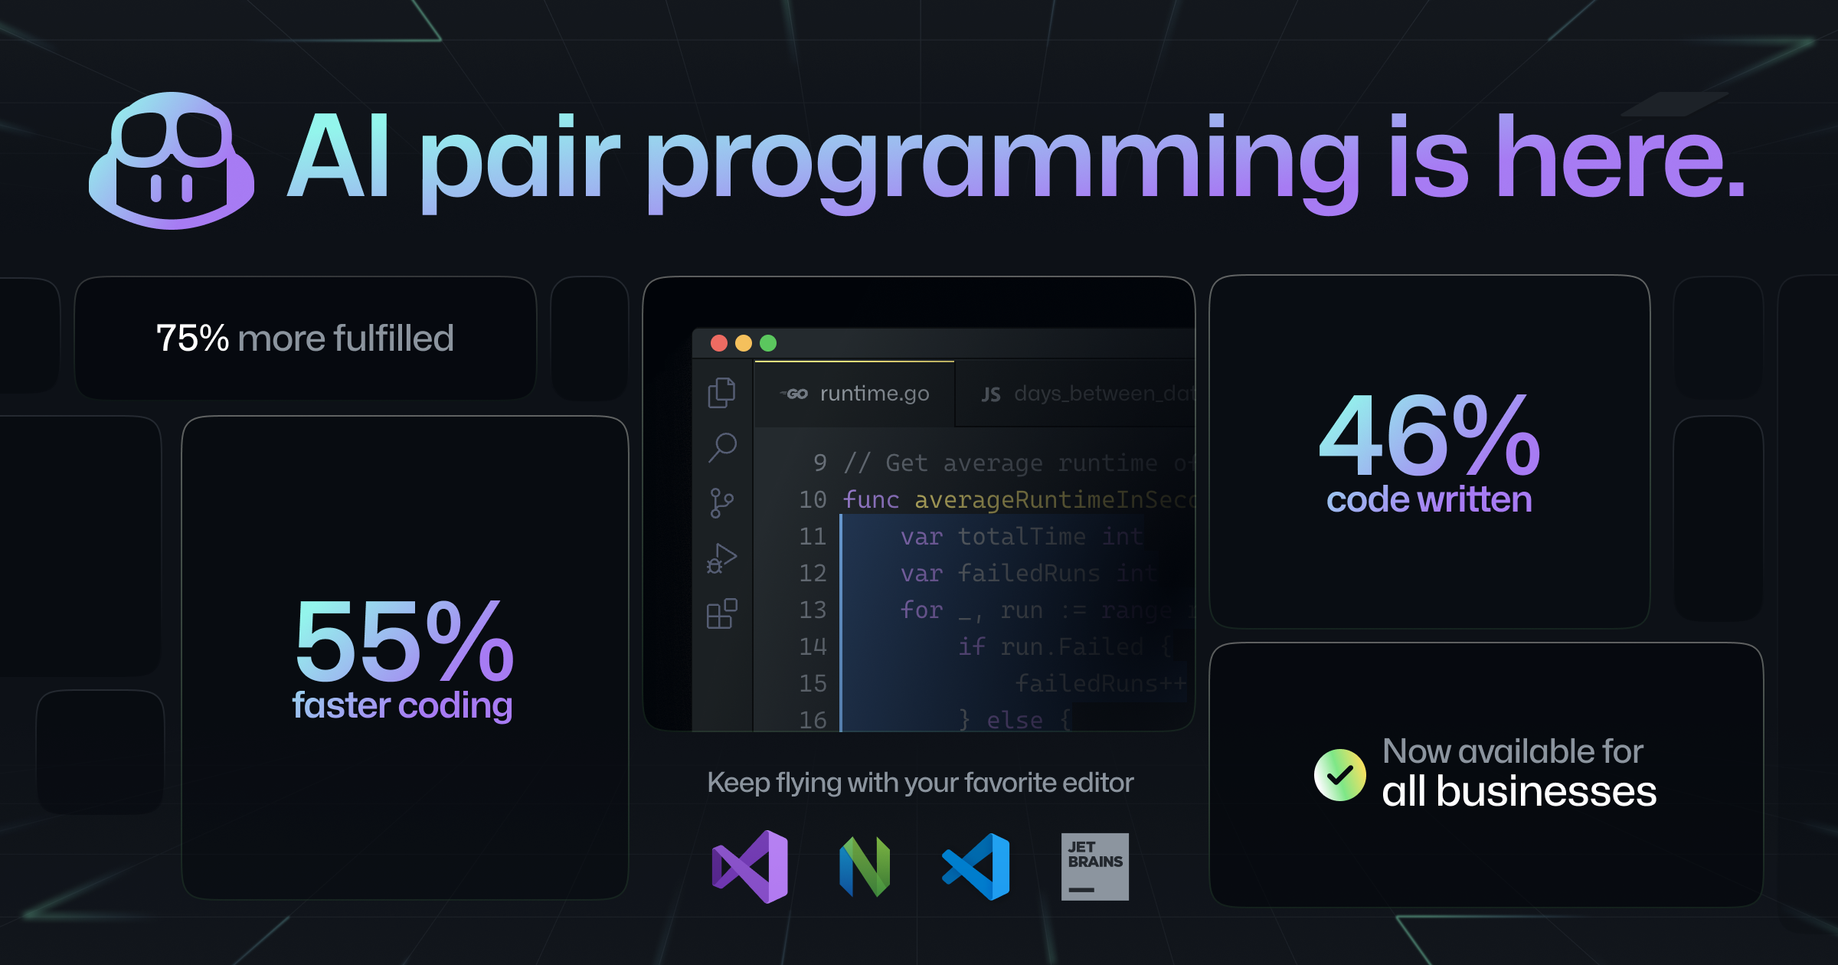
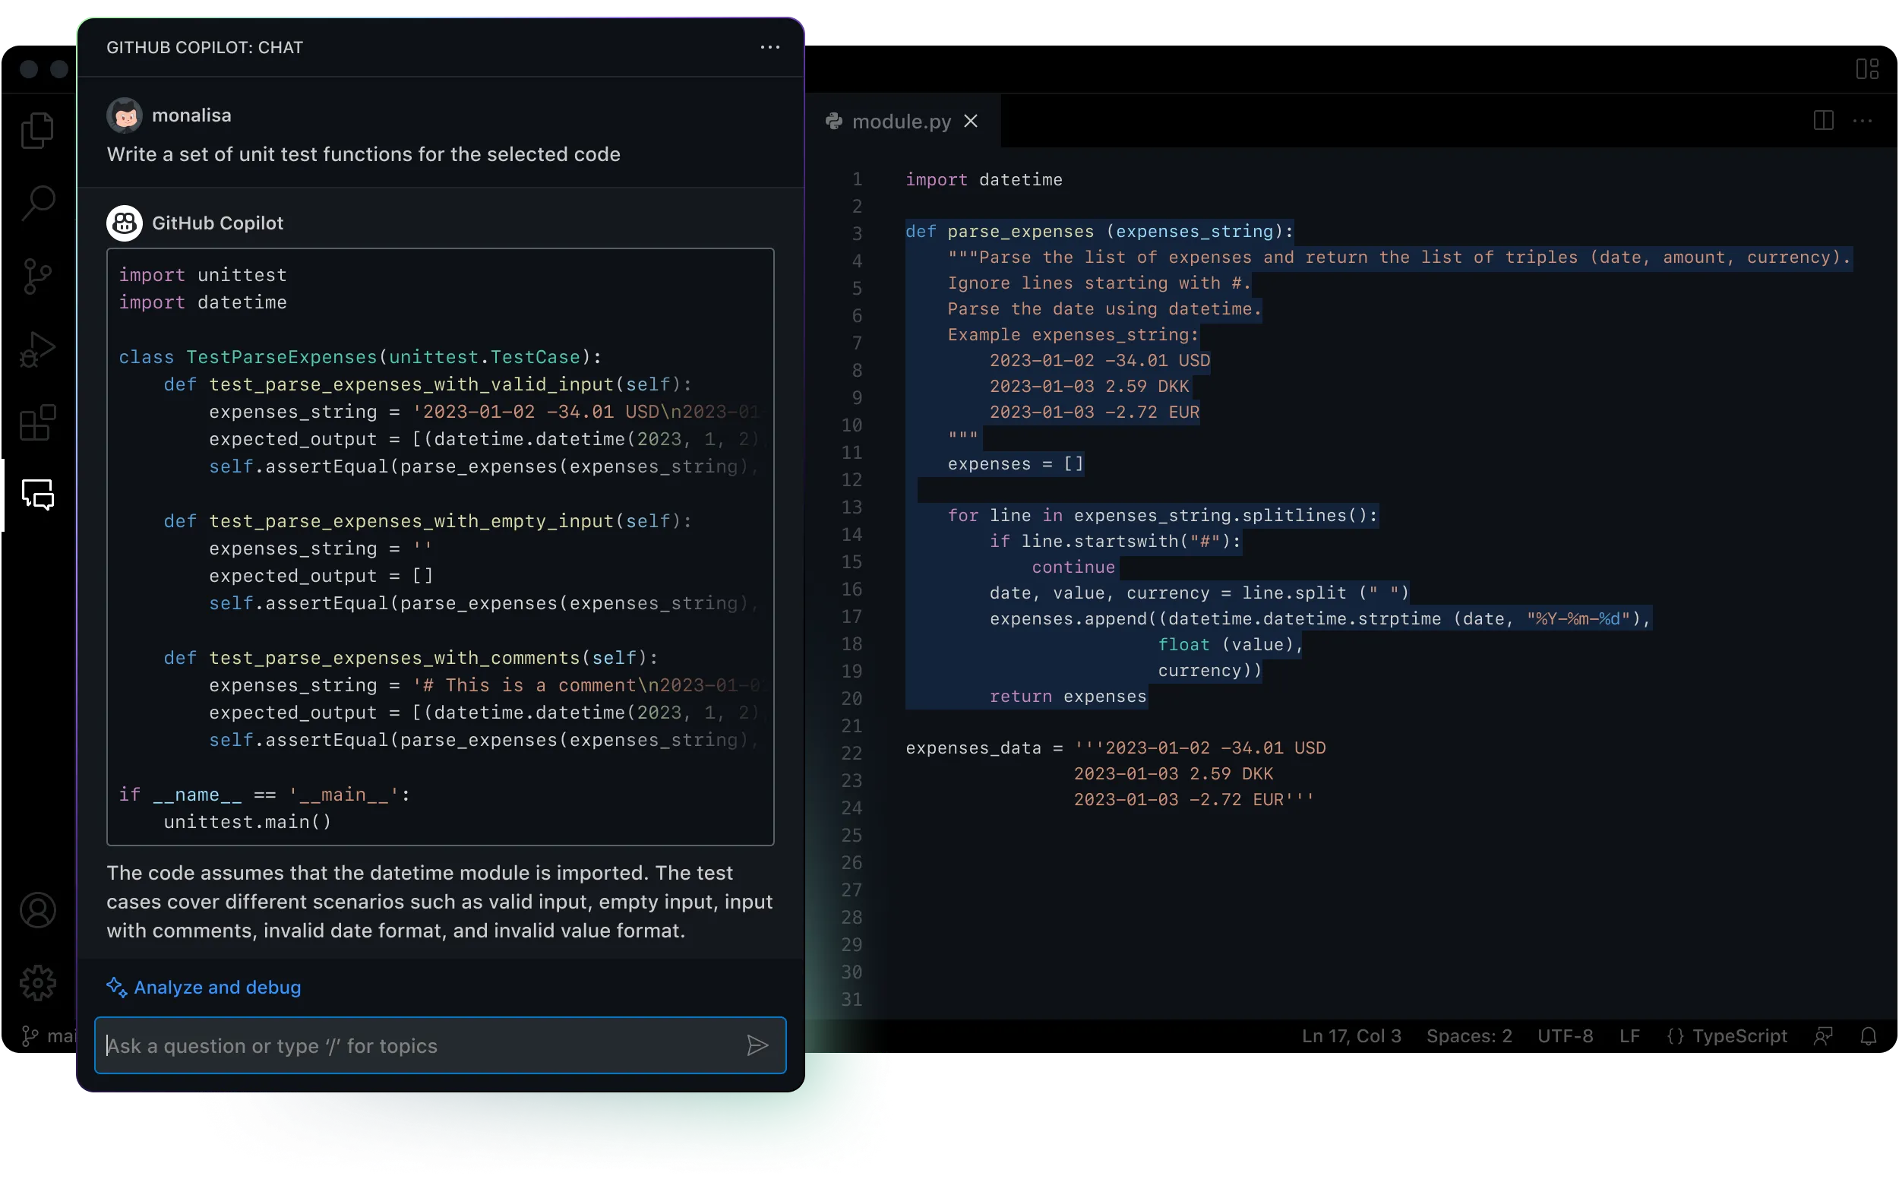

GitHub Copilot and Copilot X
Notes:
GitHub Copilot X – Chat (explain code, generate unit tests, etc.), for CLI, for Docs, for Pull Requests (description and tests), Voice

Slide 51
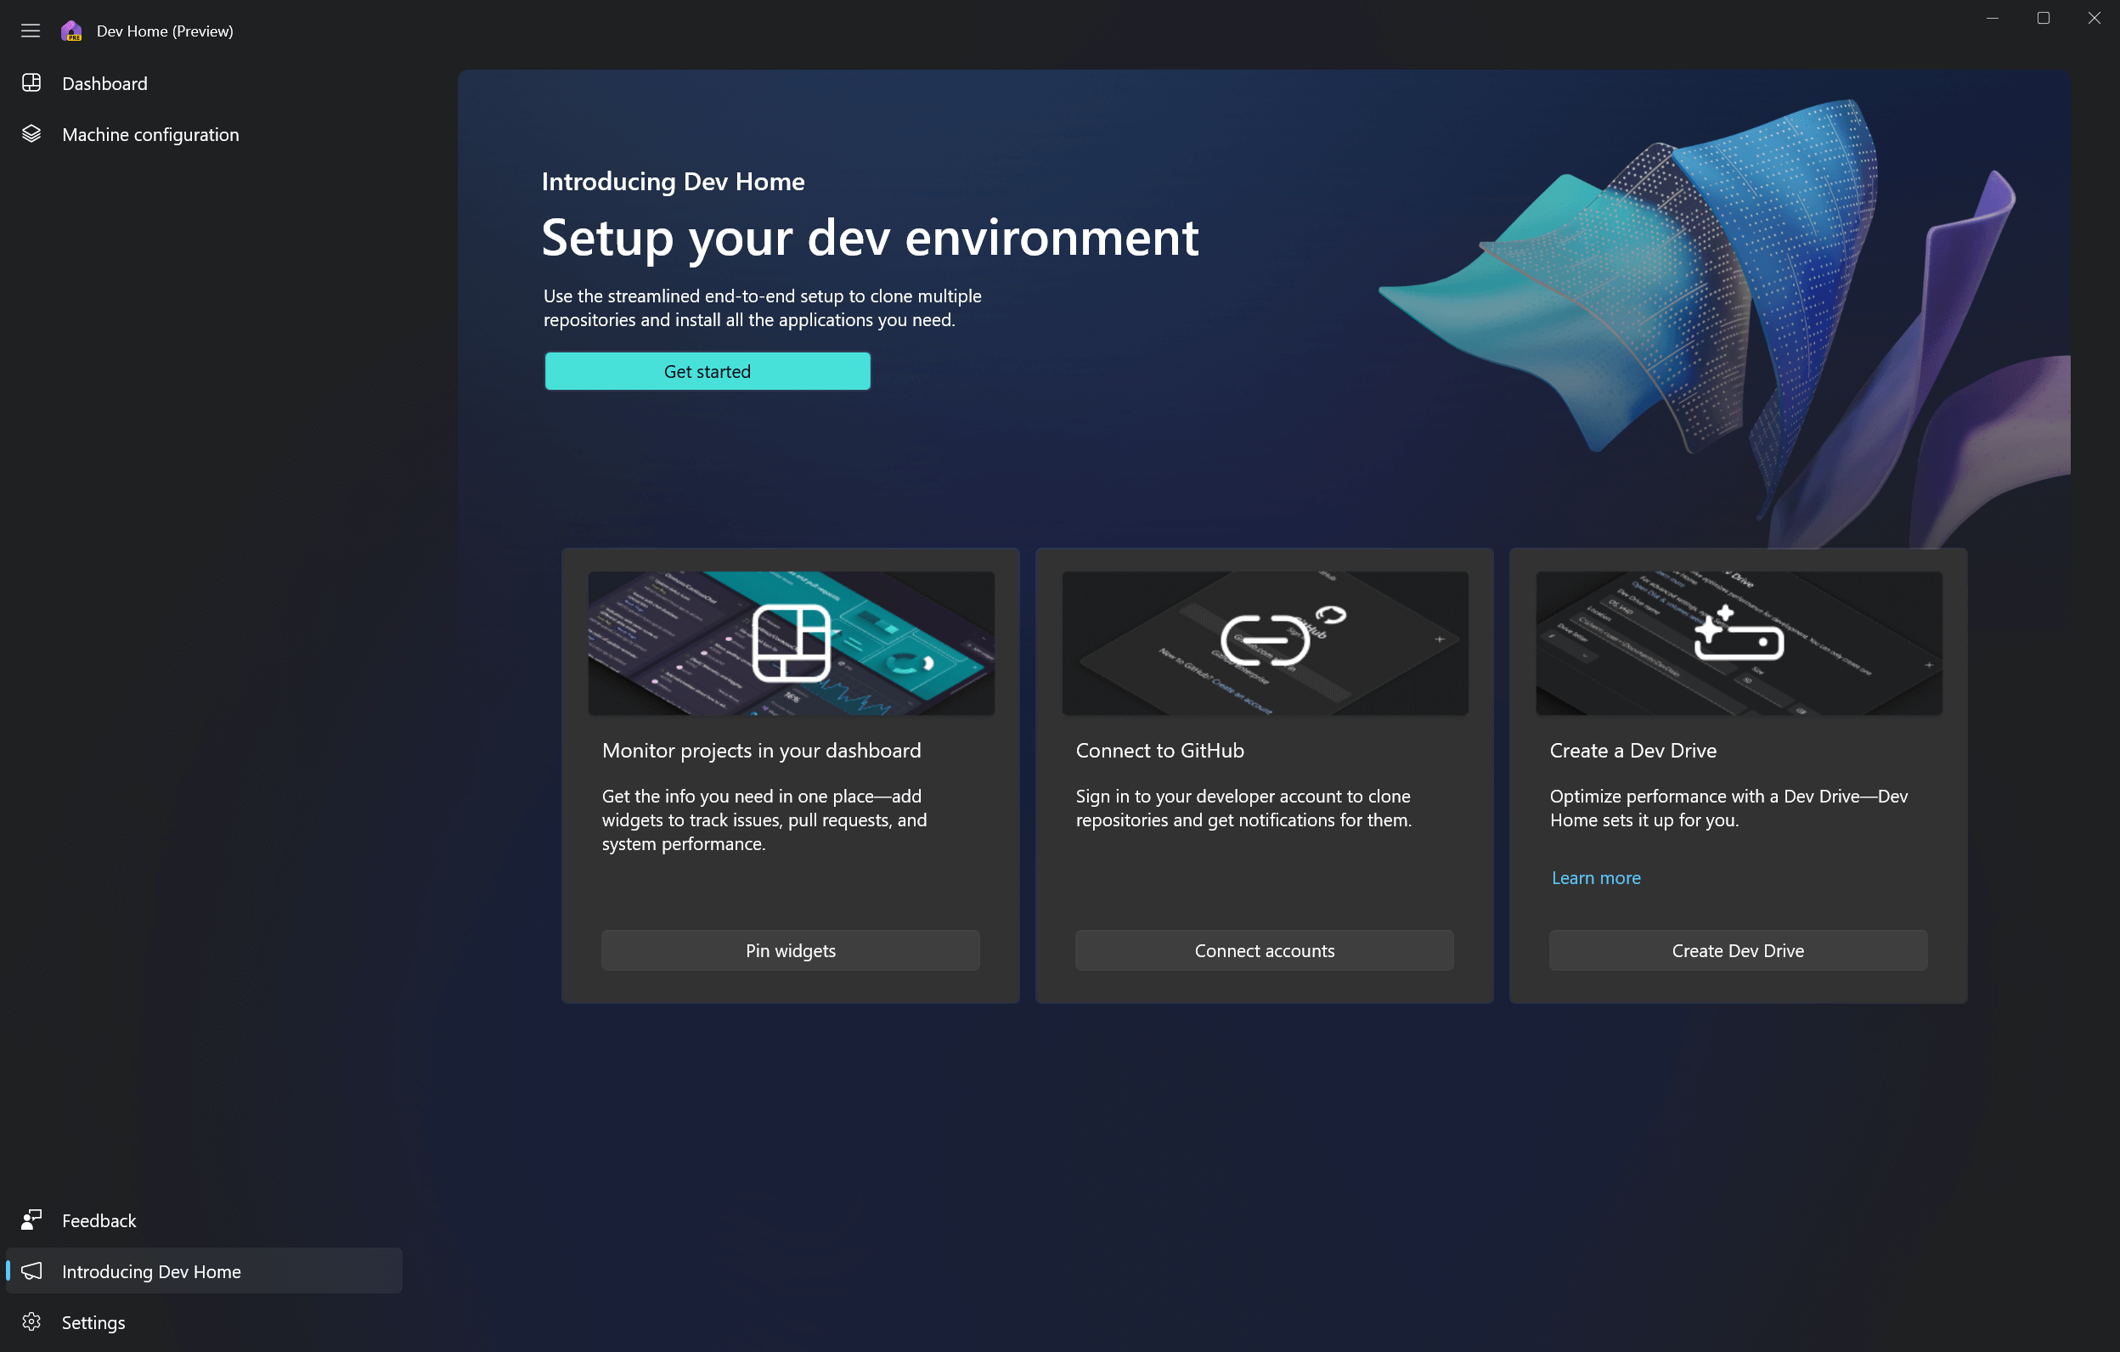
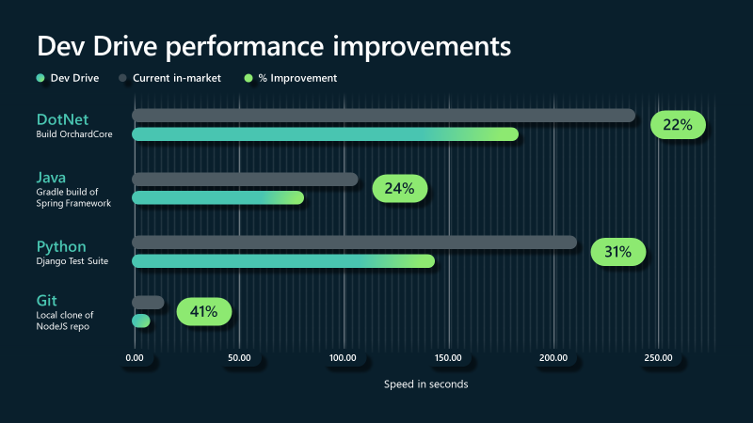
Dev Home and Dev Drive
Notes:
https://learn.microsoft.com/en-us/windows/dev-home/

Slide 52

Closing up...

Slide 53
Which .NET version to use?
.NET Framework 4.x
No!
Migrate
Reconsider architecture
.NET LTS
.NET 6, .NET 8...
For published projects that are in maintenance mode
.NET STS (Current)
.NET 7, .NET 9...
For projects in active development

Slide 54
References and the future
.NET Blog
https://devblogs.microsoft.com/dotnet/
.NET on YouTube – community standups, etc.
https://www.youtube.com/dotnet
GitHub
https://github.com/dotnet/
Themes of .NET
https://themesof.net/
C# proposals
https://github.com/dotnet/csharplang/tree/main/proposals
.NET Conf
https://www.dotnetconf.net/

Slide 55

Miroslav Popović https://miroslavpopovic.com/
https://github.com/miroslavpopovic/
https://www.linkedin.com/in/miroslavpopovic/
@miroslavpopovic
https://github.com/miroslavpopovic/what-is-new-in-dotnet
Thank you! Questions?

